Slide 1
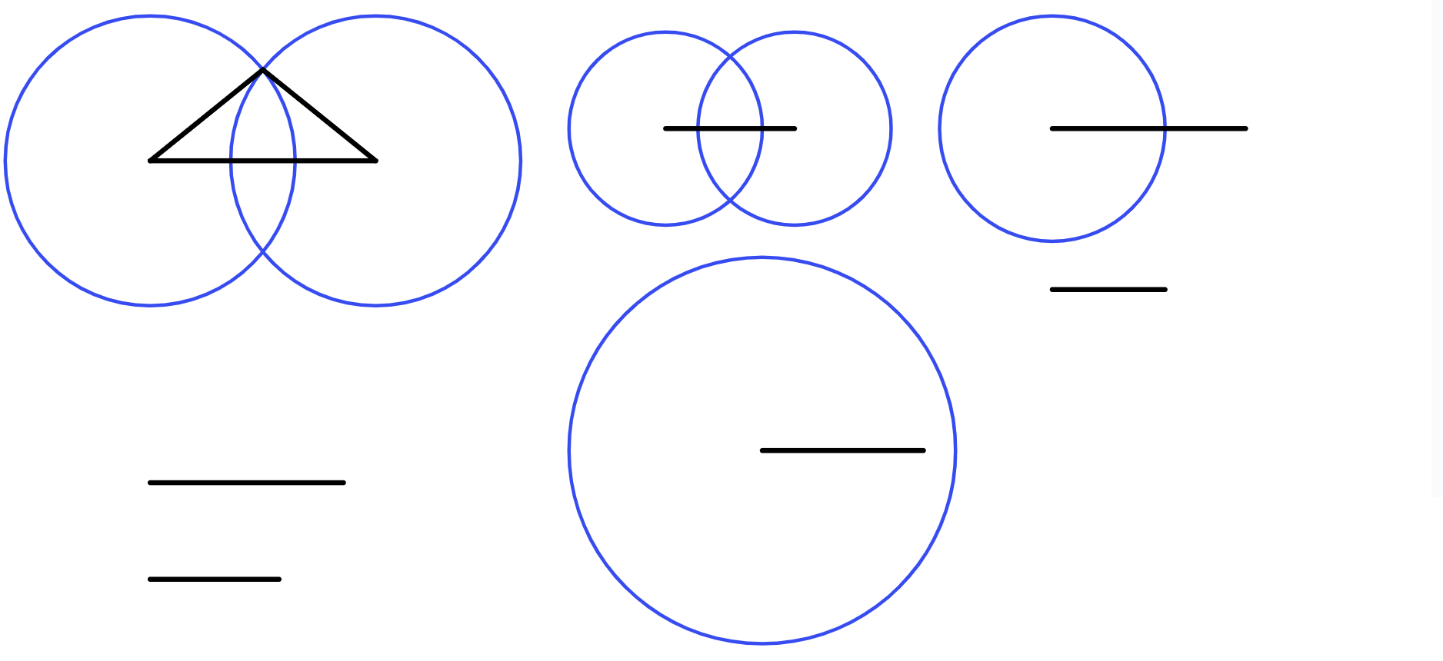
Perpendicular bisector of a line segment
Task A: Constructing rhombi to bisect a line segment
1) Give an explanation for why each construction doesn’t result in a perpendicular bisector of the line segment XY, and what can be done to make their construction better.
a)
b)
c)
X
Y
X
Y
X
Y
Both circles are too small; they do not intersect.
Both circles are different sizes.
The compass needle wasn’t placed at the endpoints X and Y. The circles are in the wrong place for the perpendicular line to be a bisector.
Make sure that you start each circle with the compass needle at one endpoint of the line segment you want to bisect.
Make each circle bigger so they can intersect with each other, but check that both circles are still the same size.
After constructing the first circle, check that your pair of compasses are still the same width apart so the second circle is the same size as the first.
You can even draw a reference line to use before you draw any circles.
2) Find the perpendicular bisector for each line segment by constructing a rhombus.
A
B
C
D
E
F
G
H

Slide 2
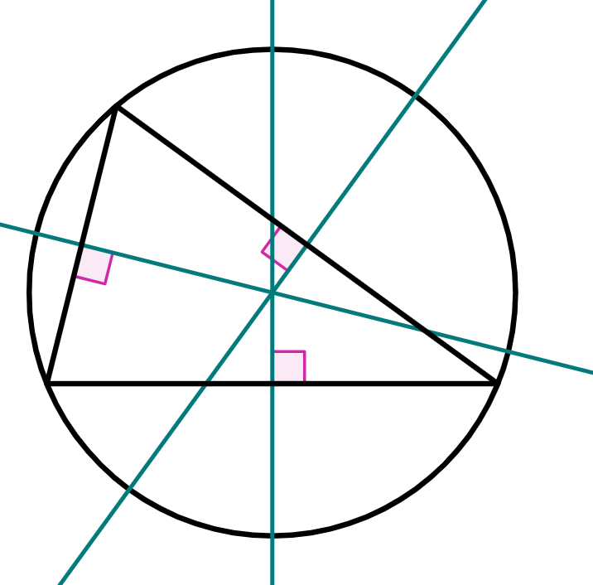
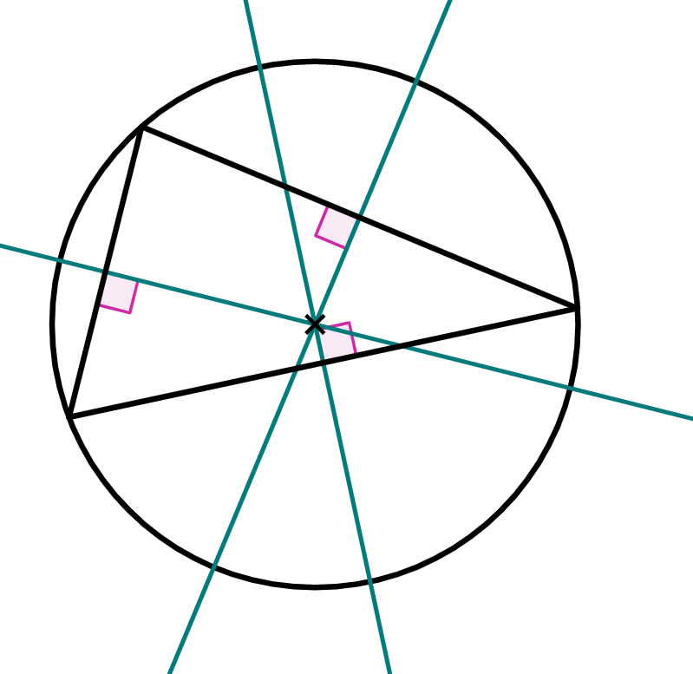
Perpendicular bisector of a line segment
Task B: Efficient construction of a perpendicular bisector
1) Complete the construction of each perpendicular bisector.
a)
b)
c)
d)
e)
2) The circumcentre of a triangle is a point that is the centre of a circle whose circumference intersects all three vertices of the triangle. The circumcentre can be found by finding the point where the perpendicular bisectors of each side of the triangle intersect.
Find the circumcentre of this triangle.
Mathematics in Education and Industry
v2.3

